Slide 1

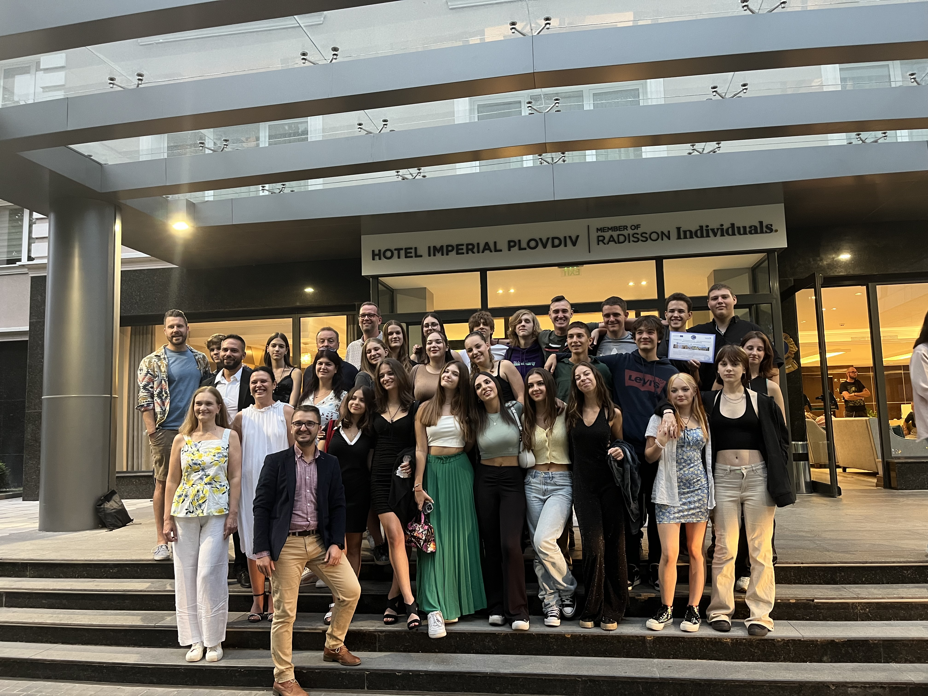
European Future
MEETING IN Budapest 2024

Slide 2
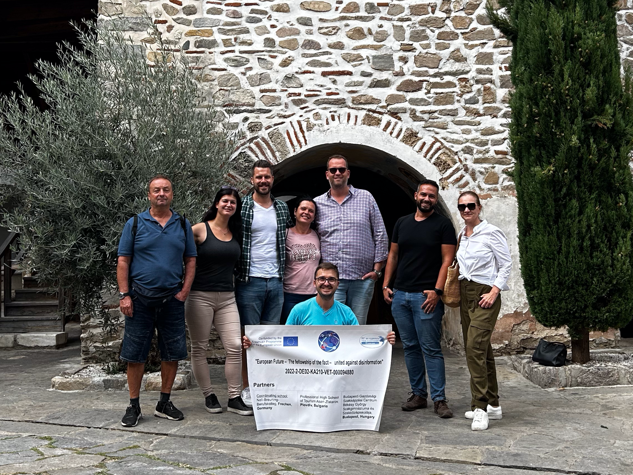

Welcome back!
Outline for the week ahead
Recap of the past meeting
Final goal for Friday
Monday’s schedule
Wednesday’s schedule
Thursday’s schedule

Slide 3

Outline for the week ahead
Time | Monday 22. 04.2024 | Tuesday 23. 04.2024 | Wednesday 24. 04.2024 | Thursday 25. 04.2024 | Friday 26. 04.2024
Morning | 09:30 – 1:00 Seminar | 6:30 Vienna Museum: European Experience | 9:30- 1:00 Second seminar | 9:30 – 11:00 Expert talk 11:00-1:00 Seminar | (Sightseeing)?
Noon |  | Sightseeing |  |  | Departure
Afternoon | Sightseeing: Parliament, St Stephen‘s Basilica Hero‘s square | Free time 5:30 Bus ride back to Budapest | 2:00 – 3:30 pm Visit the editorial office of the HVG newspaper -Margaret Island |  | Departure
Evening | Coordinator’s dinner Free time |  | Free time | 6:00 pm Farewell dinner at Trofea Obuda restaurant

Slide 4

European Future

Slide 5

Project goal
Have a lot of fun together!
Learn about all of our cultures
Create a reader for teachers & students that addresses fake news, social media usage and its dangers.

Slide 6
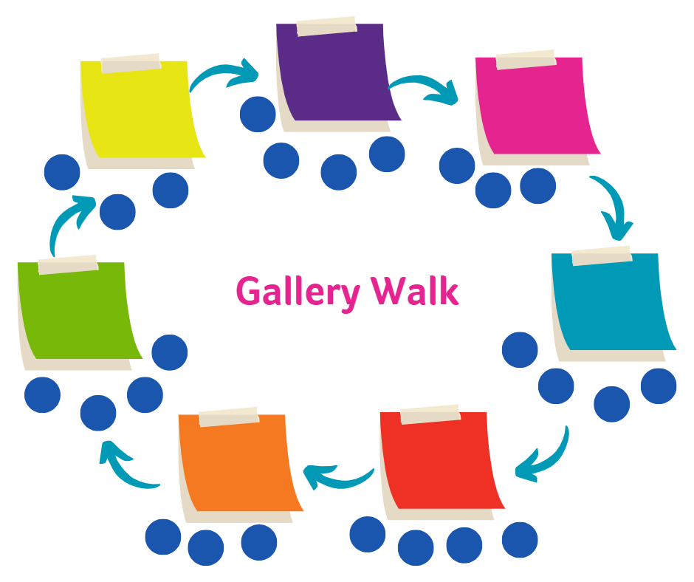
Expert work 🤓
Goals:
  Get a deeper insight into different historical aspects regarding our topic
  Create a poster in which you sum up the most important information
Method:
  gallery walk

Slide 7
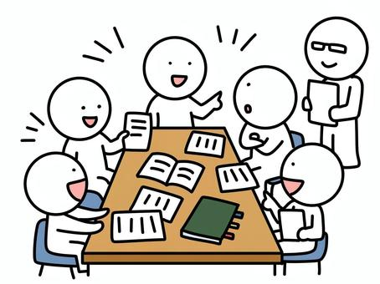
Phase 1 (ca. 90 mins.)
get together in groups of 6-7
distribute the different texts / materials
research the internet for more information on your topic (use the link list or research freely)
read the material and write down the most important aspects
discuss the aspects you need to collect on the posters
design an attractive poster

Slide 8
Phase 1 (ca. 90 mins.)
get together in groups of 6-7
distribute the different texts / materials
research the internet for more information on your topic (use the link list or research freely)
read the material and write down the most important aspects
discuss the aspects you need to collect on the posters
design an attractive poster

Slide 9
Poster
Design an attractive poster with the results of your research.
Main question:
  “What do I want to tell the others about my topic?”
Do NOT write full sentences.
Give an overview and be able to explain the poster in a short presentation.

Slide 10
Phase 2 (ca. 30 mins.)
one expert stays with the poster
the other group members walk around, read the other posters and listen to a short presentation by the expert
please exchange the expert after 10 minutes

Slide 11

Evaluation
What did you learn?
What was new / surprising / shocking?
Has this activity changed your perspective on the topic?
Think Pair Share

Slide 12
First day
Thumbs barometer 👍 👎
Give us a few opinions

Slide 13
Competence measurement
What is it good for?
  Skills for life such as teamwork, problem solving and level of effort are evaluated
  You get an individual feedback about what you’re good at and what you could still work on.
  You will get to know what your development is like at the final meeting in Cologne in autumn next year.
  Your interests are considered for the trip to Cologne.

Slide 14
Competence measurement
Team up in new groups (4-5 people)
  Harir, Todor, Bogi, Emanuela, Julia
  Lena, George, Nati, Clara, Delia
  Kitty, Jakob, Raya, Emily, Gyösö
  Andrea, Nick, Denisa, Silas, Lilli

Slide 15
Task
Plan a day of sightseeing for your stay in Cologne. (50 mins.)
stay in groups
Written tour guide and German “experts” in every group
you can also use other sources of information (smartphones, tablets etc.)

Slide 16
Competence measurement
Your coordinators prepared a feedback for you:
  Listen up
  Don’t take anything personal
  It is just a momentary image
Try to improve the next time you get confronted with such a task

Slide 17

Preparing visit to a newspaper
Later we will visit the manager and editor of HVG newspaper
In your small groups prepare some questions for the people who work there.
Especially focus on our topic of Fake News and recent changes in the world of media as well as developments in Hungary.

Slide 18
Brainstorm and share (10 min)
How do digital technologies, such as social media platforms and smartphone apps, impact individuals' mental well-being and overall mental health?
Blessing for some, curse for others.
Give examples of positive and negative impacts.

Slide 19
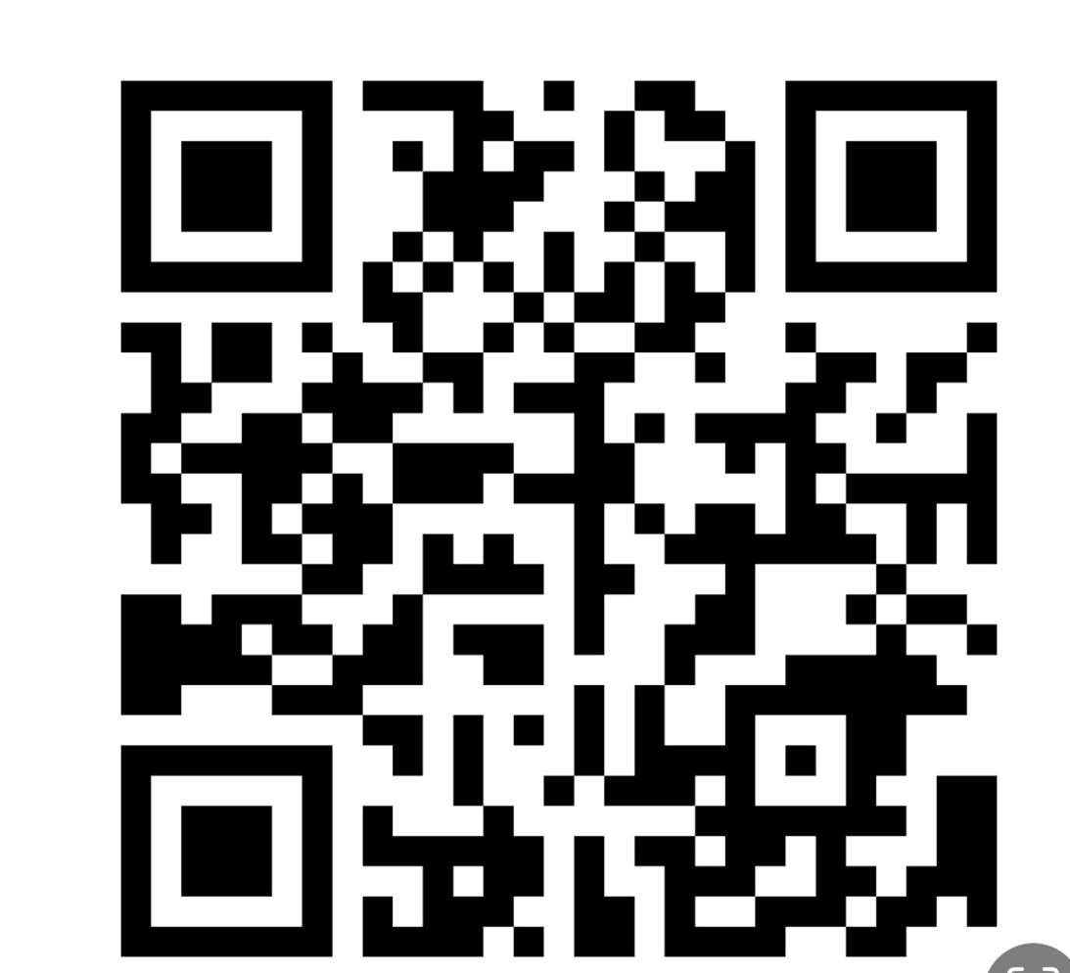
Create a slogan or motto to make a difference among peers! (15 min)
What are the potential risks associated with excessive screen time and digital device use on mental health, particularly among children and adolescents?
Go to www.mentimeter.com
Use the link : https://www.menti.com/al7vzxh38qwf
or the QR code

Slide 20
List of rules (ca. 20 mins.)
  Can you create a list of useful rules for avoiding digi addiction and achieving digi detox.
  Remember: You may help someone you love or a stranger but it’s always worth a try !

Slide 21
Case study - Digital Dilemma:
The Social Media struggle (90 min)
  Scenario
  Group discussion
  How might Emma's excessive use of social media be affecting her mental health and academic performance?
  What are the potential consequences of Emma's social media habits in the long term?
  What strategies could Emma use to develop healthier digital habits and prioritize her well-being?
  Role play - a short video or a short play
  be finished by XXX

Slide 22

Outlook
coordinators will review your results and plan a great trip to Cologne
we will work on the actual reader

Slide 23

Evaluation of the complete meeting
Your coordinators will share a questionnaire with you
Please take some time to fill it in
Give us as many details as you can

Slide 24

Thank you so much for the great time!!

