Slide 1

European Future
MEETING IN PLOVDID 2023

Slide 2

Welcome!
Outline for the week ahead
Final goal for Friday
Monday’s schedule
Wednesday’s schedule
Friday’s schedule

Slide 3

Outline for the week ahead
Time | Monday 25. 09.2023 | Tuesday 26. 09.2023 | Wednesday 27. 09.2023 | Thursday 28. 09.2023 | Friday 29. 09.2023
Morning |  | 9:00- 12:00 Learning walk with a tour guide - City center, The Old town | 9:00-13:00 Second seminar | 9:00- 12:30 Third seminar | 9:00-12:30 Final workshop & farewell
Noon | 13:00 Welcome at school | 12:00 -14:00 Free time for lunch Meeting at the Roman Stadium | 14:00 – 17:00 Cultural Tourism Bachkovo monastery National Cuisine
Afternoon | 14:30-16:00 First workshop | 14:00 City hall – meeting the mayor 14:30-15:30 Museum of Natural Sciences |  | 14:30-15:30 Meeting the manager and editor of Marica News | Departure
Evening | Free time | Free time | Free time | 18:10: Meeting in the garden - Imperial Hotel 19:00 Collective farewell dinner

Slide 4

Welcome!

Slide 5
Present yourselves (ca. 15 mins.)
Get together in international groups of three (🇧🇬🇭🇺🇩🇪)
Present yourselves and include your two facts, one lie.
Write down which lies you identified.
When everyone’s finished, reveal what the lie is.
Give yourselves one point for each lie you guessed correctly.

Slide 6

Two truths – one lie
Feedback:
  How many lies did you correctly identify?
  How was it for you to present lies about yourself?
  What made it hard or easy?

Slide 7

European Future
After getting to know you, we would also like to present the project.
Check out our Instagram account.
In your group, discuss the following questions:
  What do you think is the goal of the project?
  Which were the nicest activities during past meetings?
  What are your expectations for this meeting?
Be able to present what you discussed in a 2-minute-presentation.

Slide 8

European Future
Surprise

Slide 9

Project goal
Have a lot of fun together!
Learn about all of our cultures
Create a reader for teachers & students that addresses fake news, social media usage and its dangers.

Slide 10
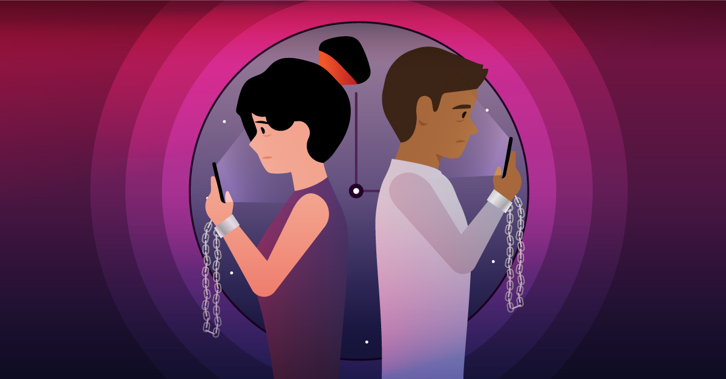
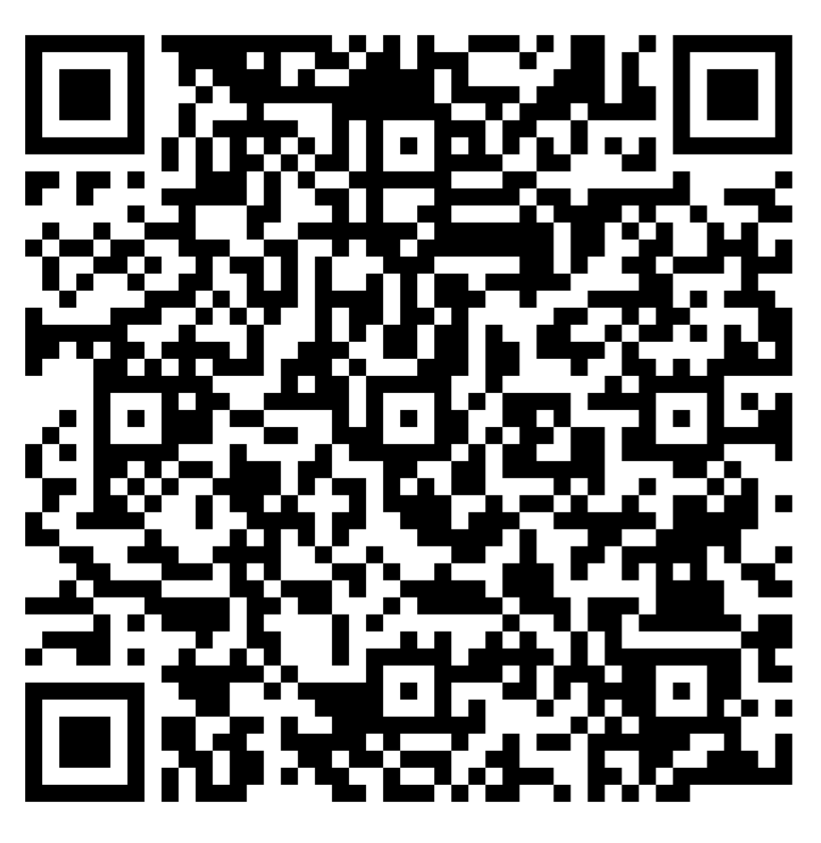
Questionnaire
Thinking about your own media consumption…
Scan the QR-code and answer the questions with your smartphone.

Slide 11
Media Consumption (ca. 30 mins.)
Check whether your assumptions about your media consumption are actually true.
  Apple phones: Settings —> Screentime
  Android phones: Settings —> Screentime / digital well-being
Discuss the results in your groups:
  Were you surprised about anything?
  Name positive and negative aspects about this media consumption.
  Be able to present your results in a mindmap and explain it to the others.

Slide 12

Preparing visit to a newspaper
Later we will visit the manager and editor of Marica News & Media – the leading South Bulgaria newspaper websites.
In your small groups prepare some questions for the people who work there.
Especially focus on our topic of Fake News and recent changes in the world of media.

Slide 13
First day
Thumbs barometer 👍 👎
Give us a few opinions

Slide 14

Warm-up: Getting information
Why do you want to know something?
How do you research information?
Which effect does it have on me?
Think Pair Share

Slide 15
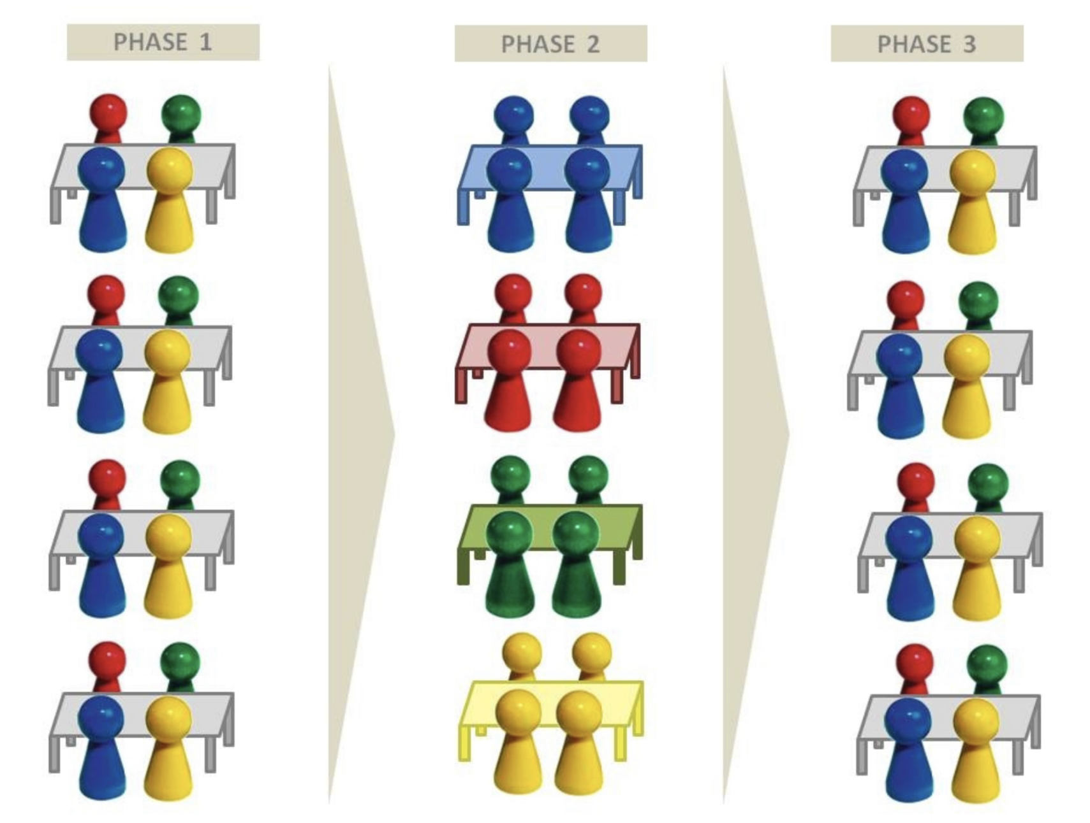
Expert work 🤓
goals:
  get a deeper insight into different aspects regarding our topic
  find a creative way to present your results to others
  you can also use other sources of information regarding your topic
method:
  group puzzle

Slide 16
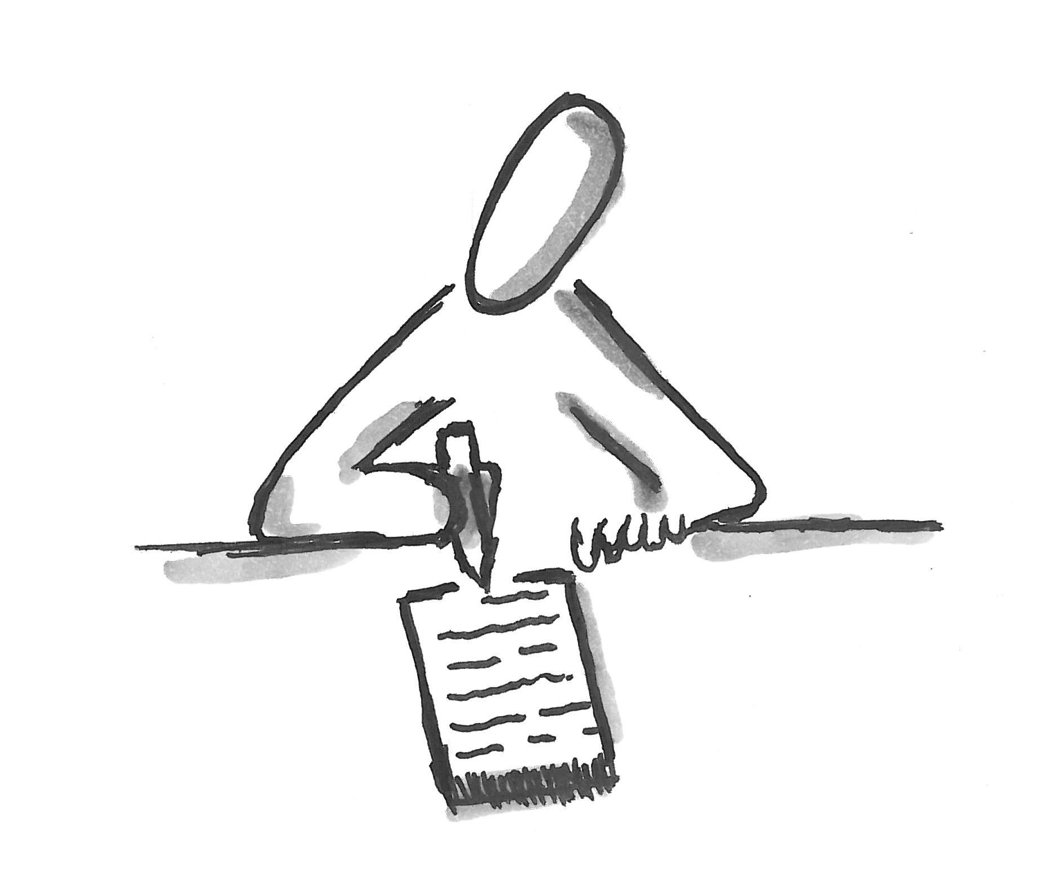
Phase 1 (ca. 30 mins.)
get together in groups of 5
distribute the different texts / materials
read the material and write down the most important aspects
think about a creative way to present your results

Slide 17
Phase 2 (ca. 90 mins.)
get together in expert groups (all the students who have worked on the same topic)
share and compare your results
find a creative way to present your results to the others (digital poster, video, reel etc.)

Slide 18
Phase 3 (ca. 30 mins.)
get together in your original groups
present your findings to the other group members

Slide 19
Evaluation
What did you learn?
What was new / surprising / shocking?
Has this activity changed your perspective on the topic?
Is there anything you’d now like to change in your personal life?
Think Pair Share

Slide 20
Competence measurement
What is it good for?
  Skills for life such as teamwork, problem solving and level of effort are evaluated
  You get an individual feedback about what you’re good at and what you could still work on.
  You will get to know what your development is like at the final meeting in Cologne in autumn next year.
  Your interests are considered for the trip to Budapest.

Slide 21
Task
Plan a day of sightseeing for your stay in Budapest.
stay in original groups
Written tour guide and Hungarian “experts” in every group
you can also use other sources of information (smartphones, tablets etc.)

Slide 22

Outlook
coordinators will review your results and plan a great trip to Hungary
we will learn more about the topic and the history of fake news / propaganda
we will start our work on the actual reader

Slide 23
Feedback time

Slide 24
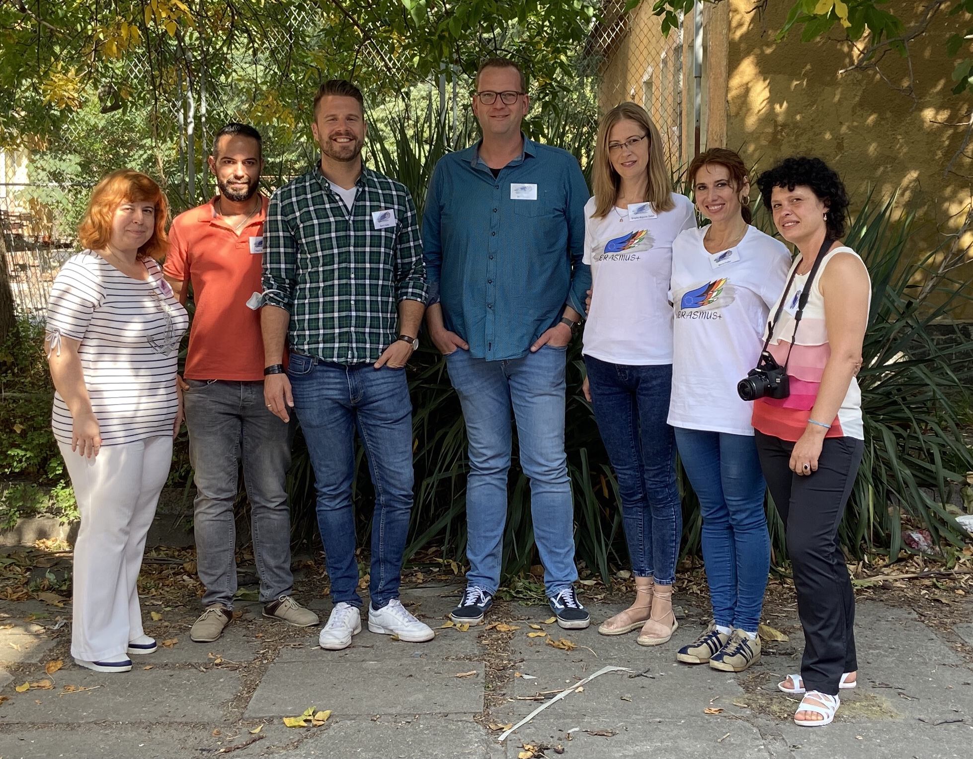
Thank you so much for the great time!!

